Slide 1
Assignment No. 5
Title: Interface in Java
Aim: Design and develop a context for given case study and implement an interface for Vehicles Consider the example of vehicles like bicycle, car, and bike. All Vehicles have common functionalities such as Gear Change, Speed up and apply breaks .Make an interface and put all these common functionalities. Bicycle, Bike, Car classes should be implemented for all these functionalities in their own class in their own way.
Objectives: To understand Interface in Java
Theory:
What is Interface in Java
- Syntax to declare Interface
- Abstract Class
- The relationship between classes and interfaces
- Variables in Interfaces
2. Multiple inheritance in Java by interface
3. Interface vs Abstract Class

Slide 2
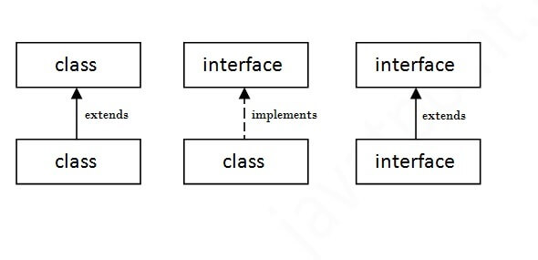
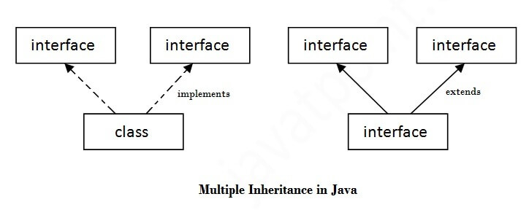
2. The relationship between classes and interfaces
3. Multiple inheritance in Java by interface

Slide 3
Assignment No. 5
interface printable{
void print();
}
class Example implements printable{
public void print()
{
System.out.println("Hello");
}
public static void main(String args[]){
Example obj = new Example();
obj.print();
}
}
1.Java Interface Example:
Create a interface printable with print method.
Create a class to implement the interface
Input: Message String
Output: Print Message string
2. Write an example program for Shape interface
Input: radius, length, breadth
Output: Print area of circle and
area of rectangle

Slide 4
Assignment No. 5
Interface Shape
{
void area ();
void volume ();
double pi = 3.14;
}
class Circle implements Shape
{
double r;
Circle (double radius)
{r = radius; }
public void area ()
{
System.out.println ("Area of a circle is : " + pi*r*r );
}
}
class Rectangle implements Shape
{
double l,b;
Rectangle (double length, double breadth)
{
l = length; b = breadth;.
}
public void area ()
{
System.out.println ("Area of a Rectangle is : " + l*b );
}
}
class InterfaceDemo
{
public static void main (String args[])
{
Circle ob1 = new Circle (102);
ob1.area ();
Rectangle ob2 = new Rectangle (126, 2355);
ob2.area ();
}
}

Slide 5
Assignment No. 5
Implements Implements
Text Book referred for assignment 1
E. Balaguruswamy, “Object Oriented Programming Using C++ and Java”, Tata McGrawHill
Java The complete reference, 9th edition, Herbert Schildt, McGraw Hill Education (India) Pvt. Ltd.
Interface Vehicle
void changeGear(int a);
void speedUp(int a);
void applyBrakes(int a);
Class Bicycle
Class Bike

Slide 6
Assignment No. 5
Frequently Asked Question:
Write a java interface which provides the implementation of Bank interface to calculate Rate of Interest.
Write a Drawable interface has only one methoddraw(). Its implementation is provided by Rectangle and Circle classes
A class implements an interface, but one interface extends another interface.
Create a vehicles as interface mention all common functionalities and create classes like bicycle, car, bike implement all these functionalities in their own class in their own way.
Create a animal class using interface and provide some common functionalities and implement into some other classes.
Mapping of Course Outcomes for Assignment 5: CO1
CO1: Differentiate various programming paradigms and apply basic concepts of OOP.

